Slide 1
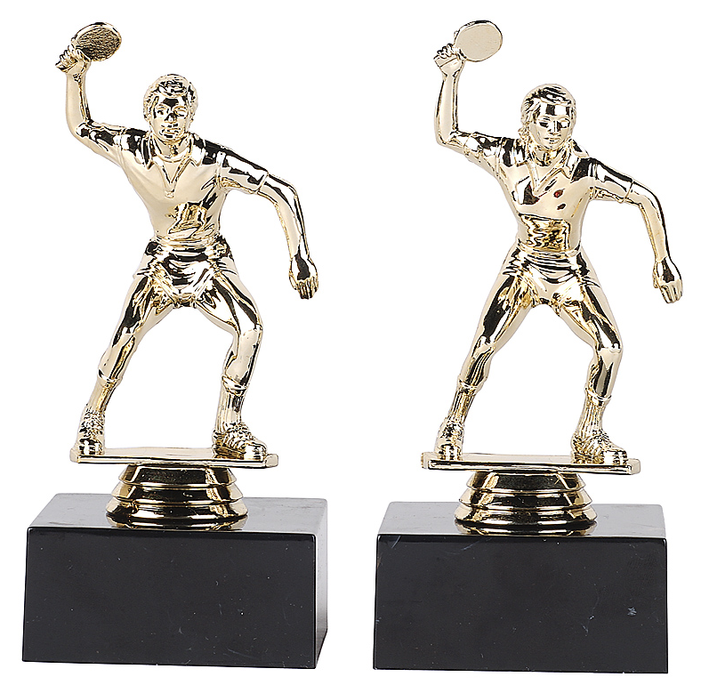
Power Poses

Slide 2
Amy Cuddy

Slide 3
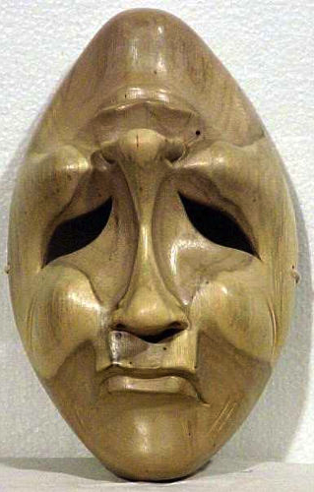
Stand up.
Close your eyes.
Think about a time
you felt sad or
depressed.

Slide 4
Sad or
depressed.
Ask yourself the
uestions
to remember clearly.
Notes:
When did this happen?
Where were you?
Who were you with?.
What happened/
Why did it happen?
How did you feel?

Slide 5
Notice your
body position
Notes:
Usually head down. Slumped.

Slide 6
How you feel
effects
body position

Slide 7
Stand up.
Close your eyes.
Think about a time
you felt happy.

Slide 8
Happy.
Ask yourself the
uestions
to remember clearly.
Notes:
When did this happen?
Where were you?
Who were you with?.
What happened/
Why did it happen?
How did you feel?

Slide 9
Notice your
body position
Notes:
Usually head down. Slumped.

Slide 10
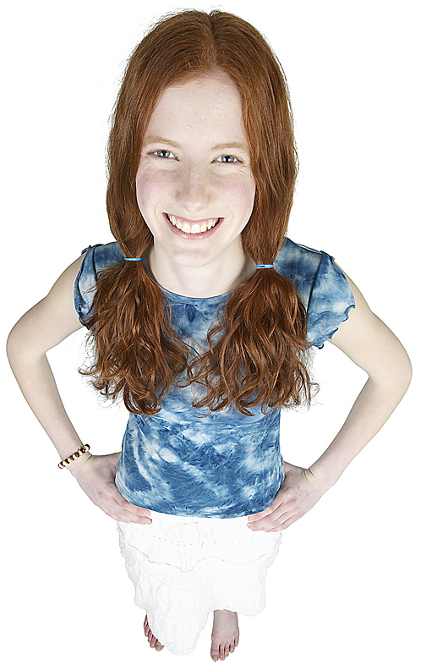
You know
how you
feel
affects
body
position

Slide 11
Did you know
how you
feel
affects
body
position
?

Slide 12
Let’s try!

Slide 13
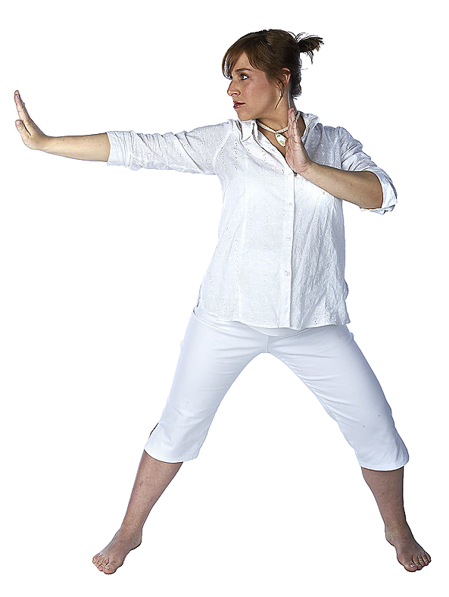
Vocabulary check: Body parts
arm
head
neck
hand
shoulder
chest
elbow
stomach
leg
foot

Slide 14
Vocabulary
check
Insert video
breathe
out though mouth
Notes:
Pairwork, then teach other pair

Slide 15
strong
Vocabulary
check
powerful
muscle
Notes:
Pairwork, then teach other pair

Slide 16
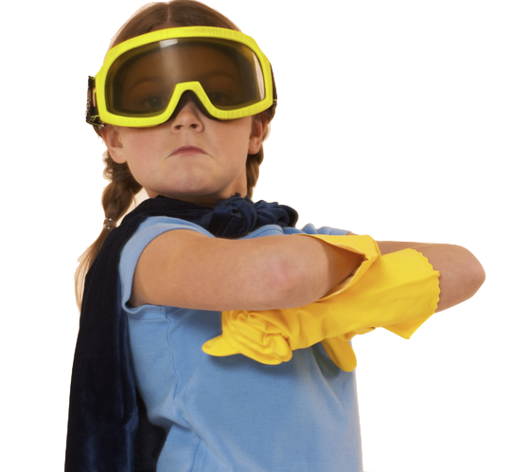
Vocabulary
check
confident
Notes:
Pairwork, then teach other pair

Slide 17
Power Poses are body positions.
Many people experience
interesting results.
Do you?

Slide 18
Make your body BIG

Slide 19
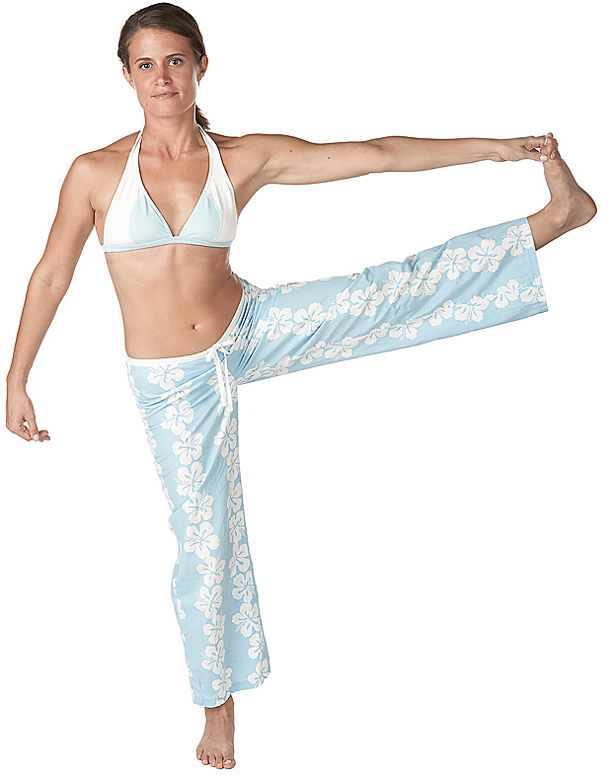
Make your body BIG

Slide 20
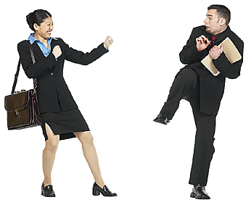
Make your body BIG

Slide 21
Power pose

Slide 22
Slide from Amy Cuddy’s TED talk.
テストステロン
+19%
-10 %
Notes:
Max: 29% difference. Rouighly 1/3. Would you like to give yourself a 30% advantage.

Slide 23
Slide from Amy Cuddy’s TED talk.
コルチゾール
(Stress hormone)
ストレスホルモン
+17%
- 25%
Notes:
Fight, flight or freeze hormone: 42%

Slide 24
50-50:
86%
50-50:
60%
1 in 6:
33%
1 in 6:
8%

Slide 25
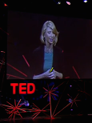
Let’s
watch

Slide 26
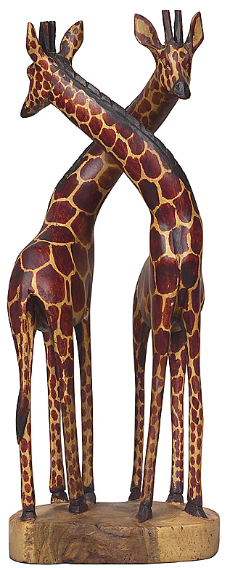
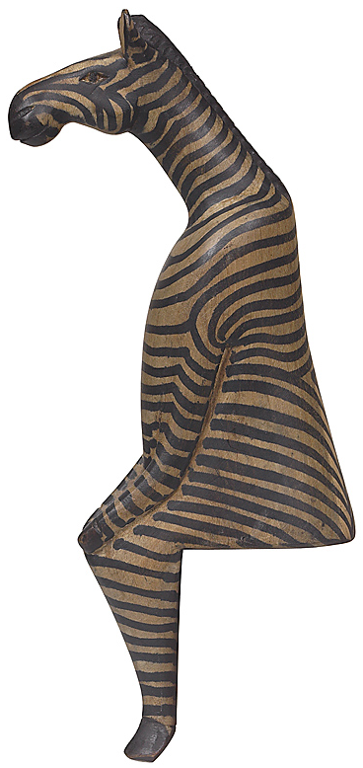
Divide the class into 4 groups: A, B, C & D
Each person gets
a handout.
A, B, C or D

Slide 27
With your partner, read the handout.
Practice.
Learn the
Power Pose.

Slide 28
Join a partner from a different group.
Join
A
B
←→
Teach your
power pose.
Learn theirs.
←→
← →
←→
← →
C
D
Change partners.
Continue.
←→
Notes:
This position is called King or Queen of the world.
You might want to close your eyes.
Stand with your feet about
45 centimeters* apart. (* 45 cm = 18 inches)
Stand up straight.
Push your chest out.
Hold your head up a little.
Hold your arms out to your side.
Raise your hands up.
Take a deep breath.
You are “King (Queen) of the world.”
Maybe you are going to hug the world!
Keep this position for one minute.
Then say:
Notice your body. How do you feel?
Notice your breathing. Is it fast or slow?
Notice your muscles.
Your stomach.
Your chest.
Your neck.
Your head.
Your shoulders and arms.
Notice your feelings.
Do you feel strong?
Do you feel confident?
Do you feel powerful?
If this “power pose” makes you feel good,
you can use it any time you want to feel this way.

Slide 29
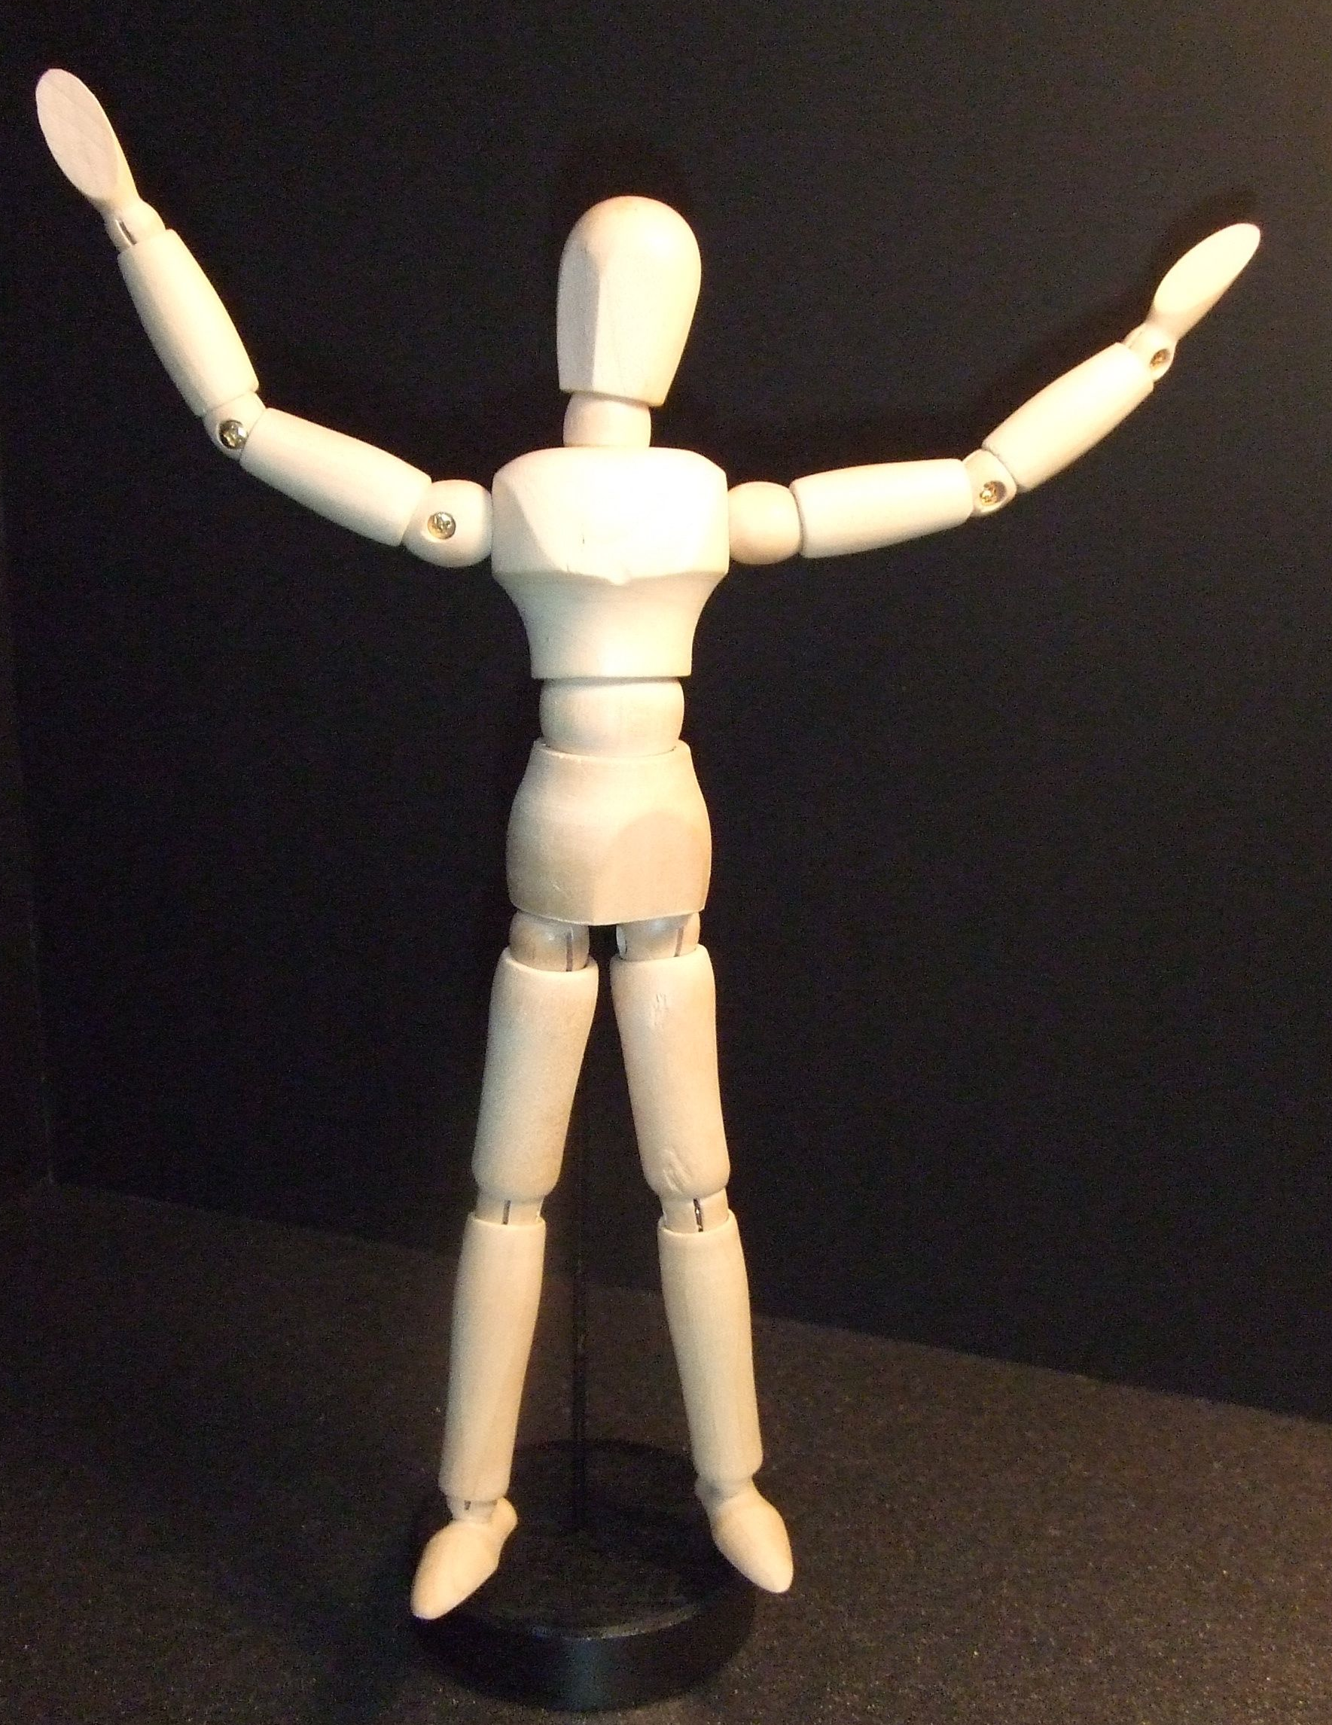
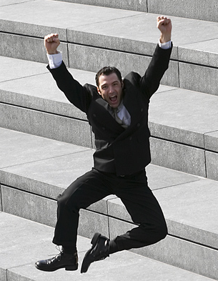
Power Pose
King/ Queen
of the World
?
a

Slide 30
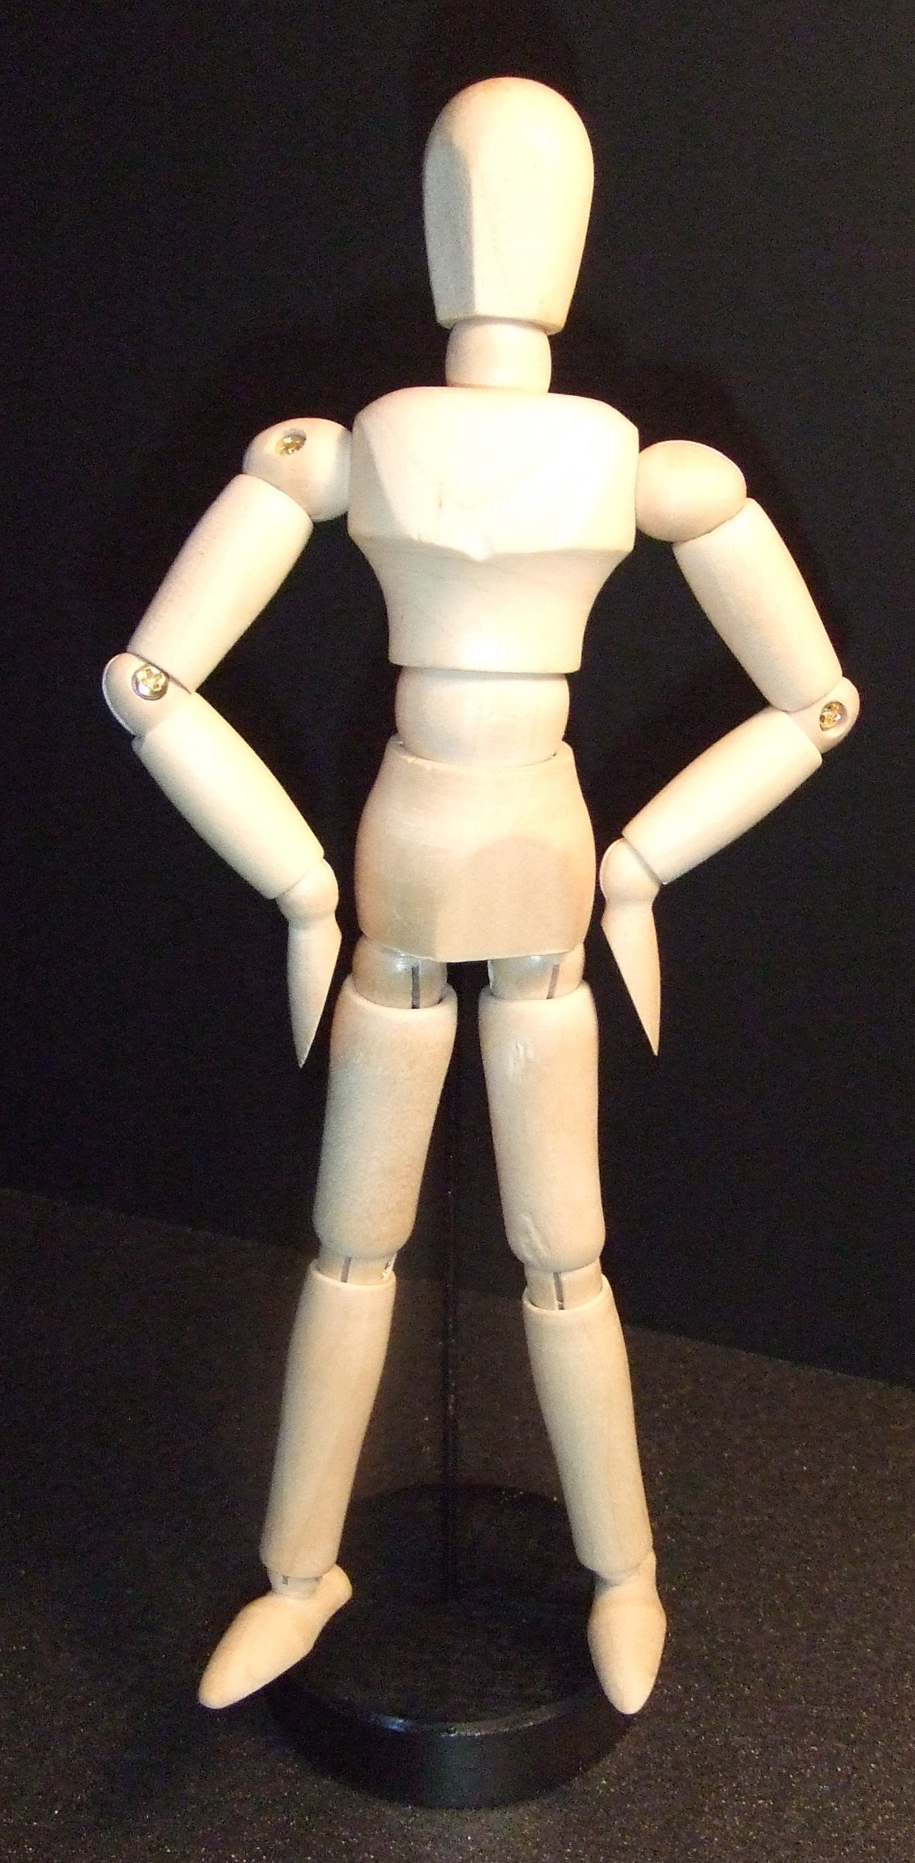
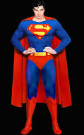
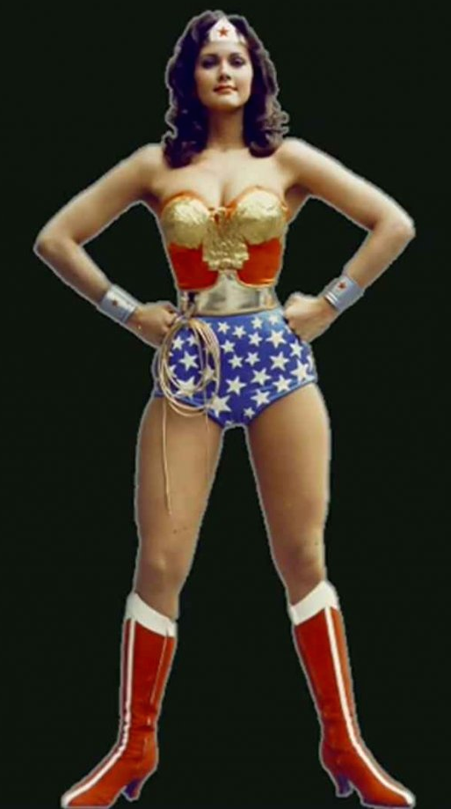
Wonder Woman / Superman
a

Slide 31
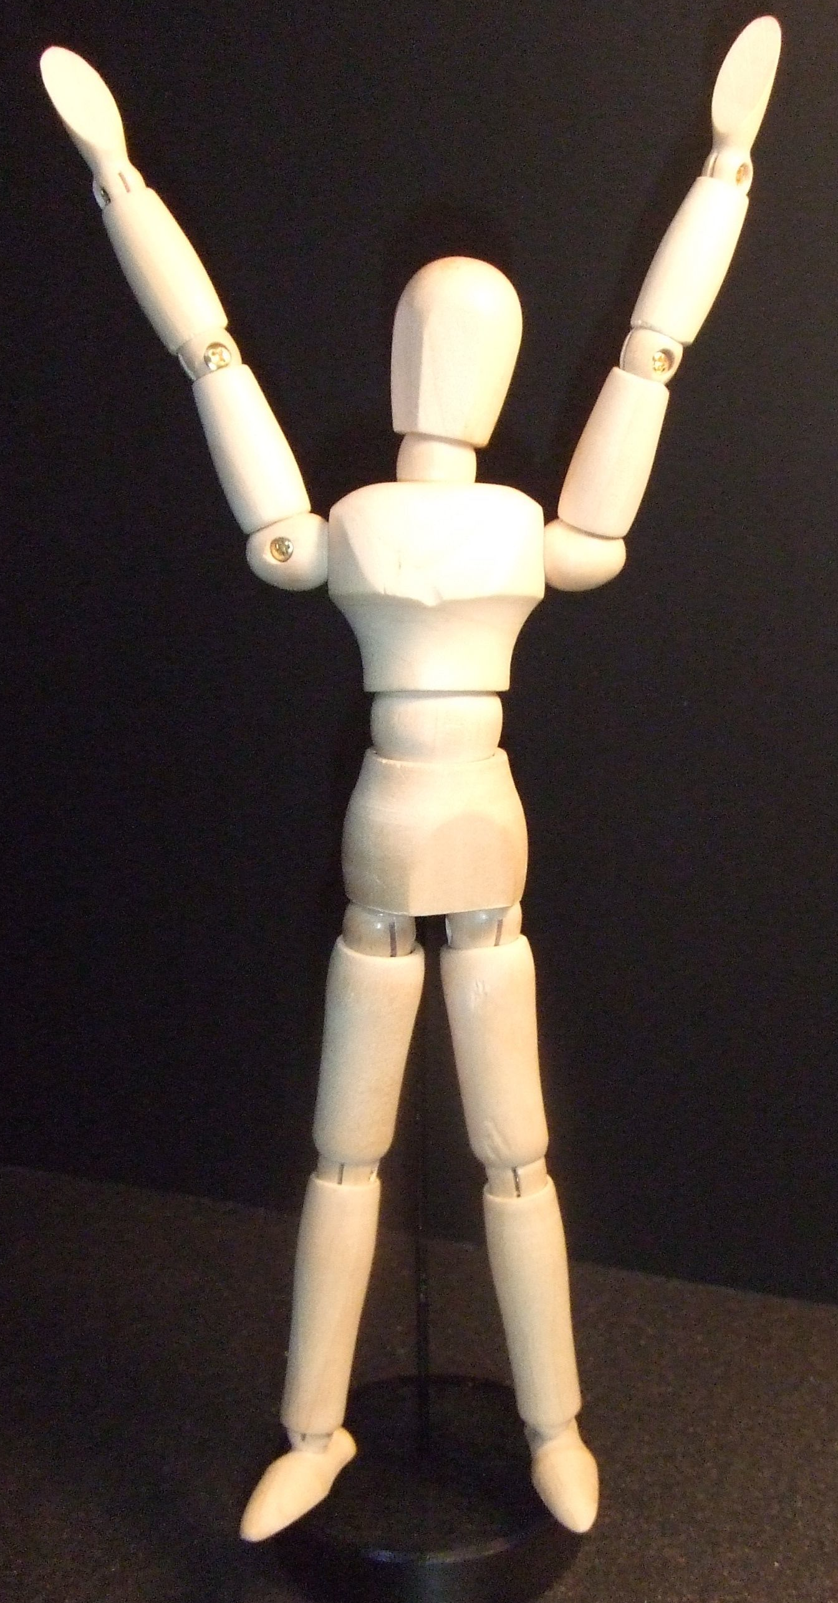
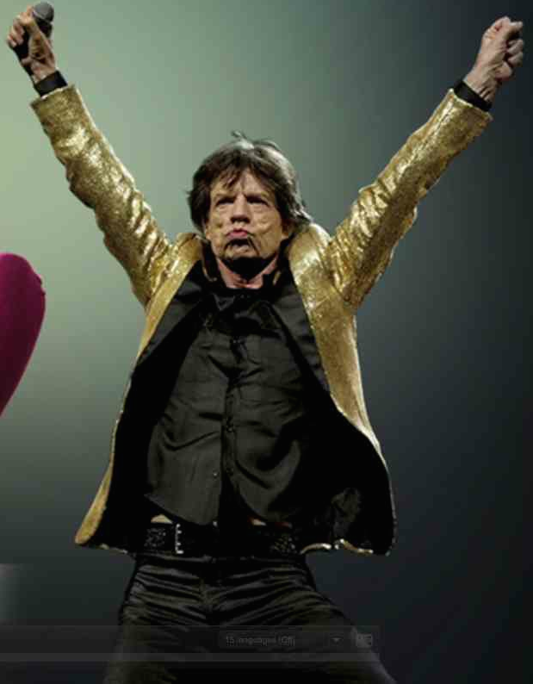
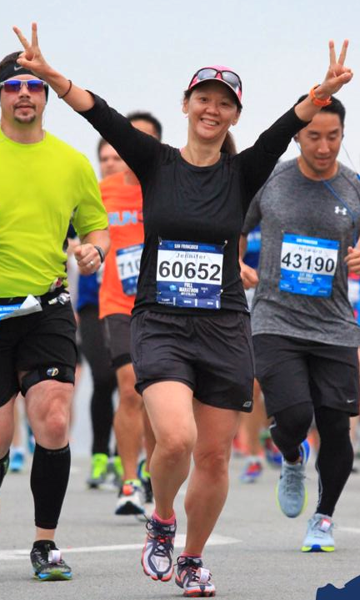
Victory
a

Slide 32
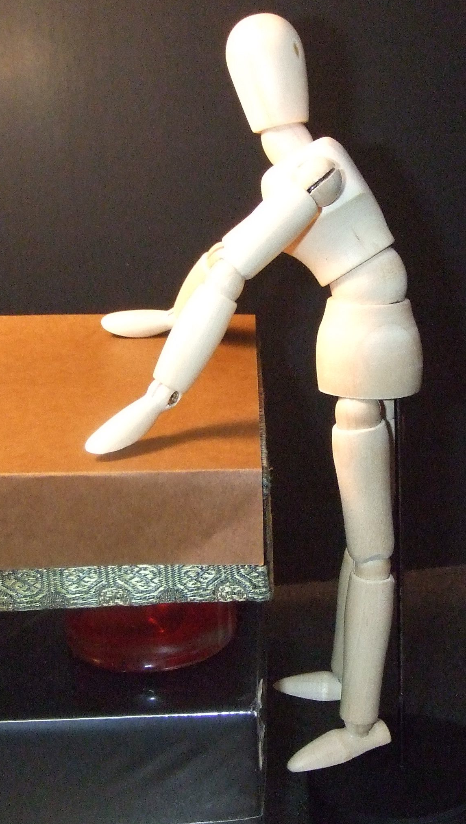
Lean in!
a

Slide 33
a

Slide 35
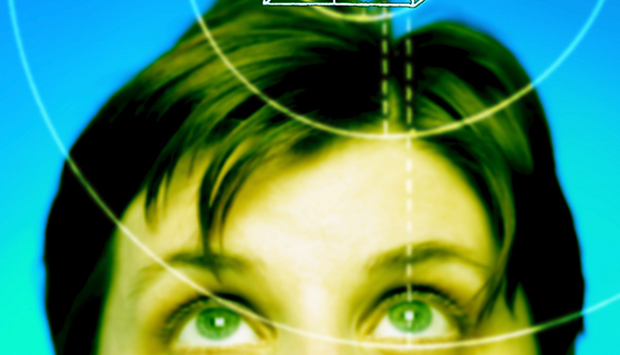
Think Ahead:
Positive
Self-talk

Slide 36
Positive
Self-talk
I am _____.
positive adjective
awesome!
great!
fantastic!
kind!
cute!
smart!
Notes:
Info about Ss with low self-esteem. (I’m a good person. I’m not a good person and now I’m a liar, too).

Slide 37
Linguistic
Kross, et al. 2014
Self-distancing
You are ___.
I am _____.
(Your name) is ___.
awesome!
great!
fantastic!
kind!
cute!
smart!

Slide 38
Power Pose
(Your name)
is ….
a

Slide 39
Let’s try together

Slide 40
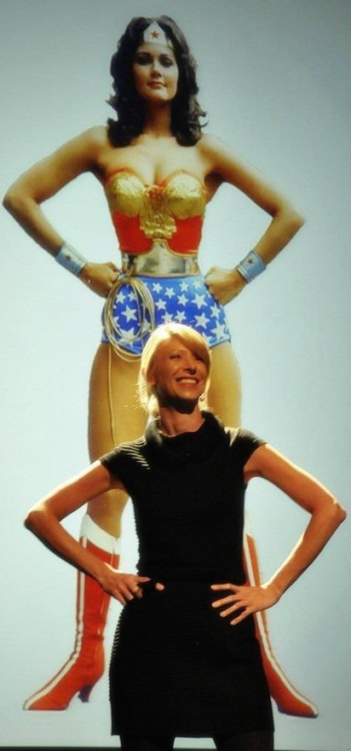
Fake it
‘till you make it. Fa
Power
Pose
Fake it,
until you
make it.
Amy Cuddy
BECOME it
Amy
Cuddy

Slide 41
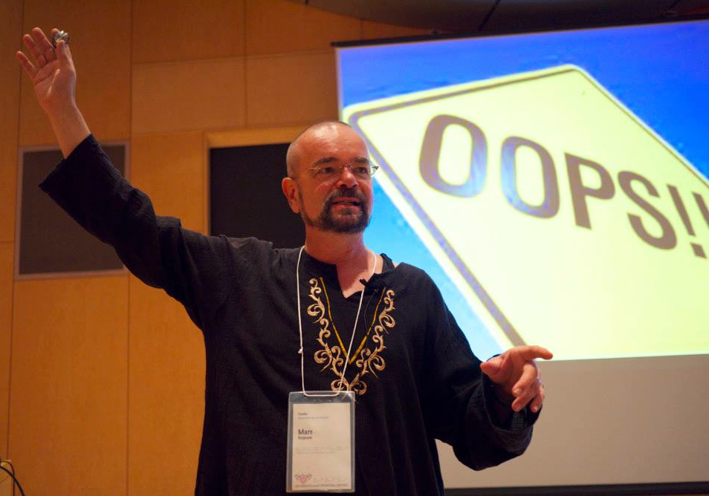

Slide 42
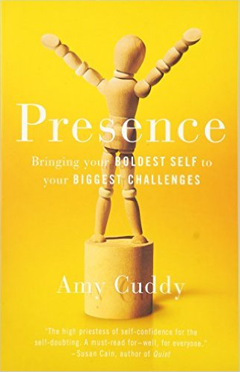
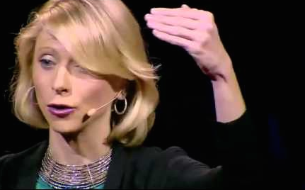

Slide 43
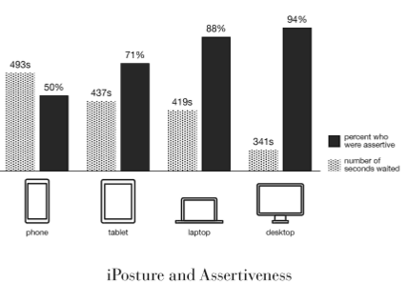
iPosture simulation
積極的
1
Notes:
Sekyoku-teki (ga gakusei/ businesswoman) .

